Slide 1
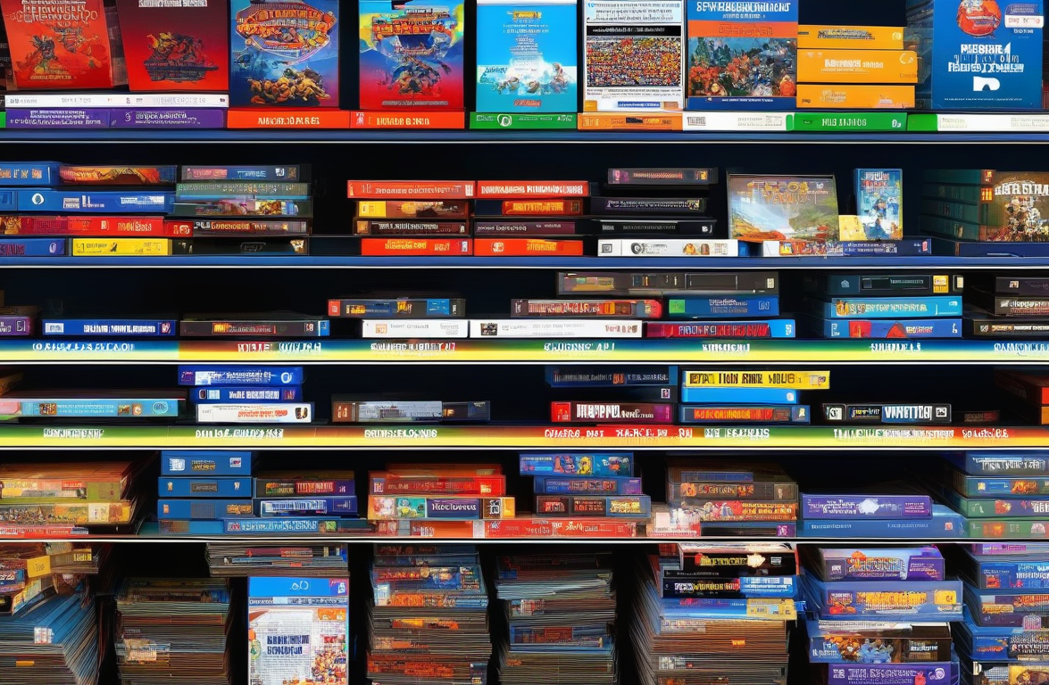
Digital Game Library
This project aims to create a Digital Game Library, similar to platforms like Steam. The main goal of the application is to provide a platform for users to manage and access their digital game collection efficiently.
The primary users of this application will be gamers who have a vast collection of digital games and want an organized system to manage them. This application will resemble platforms like Steam, Epic Games Store, and GOG but will have its unique features tailored to the needs of our target users.
The application will allow users to add games to their library, categorize them, track their playtime, and even provide recommendations based on their gaming preferences. It will also have social features allowing users to connect with friends, see what they are playing, and join multiplayer games with them.

